Slide 1

MINOR PROJECT-II
MID SEM PRESENTATION ON
Visualization of CPU Scheduling Algorithms

Slide 2
PRESENTED BY
ANKITA RANI SUBHAM KUMAR AMAN KUMAR
R610218008(CS-MFT) R610218030(CS-MFT) R610218005(CS-MFT)
UNDER THE GUIDANCE OF :
MR. SUMIT KUMAR
Assistant professor
School Of Computer Science and Engineering

Slide 3
Abstract
Scheduling is the technique used for controlling the order of the job which is to be performed by a CPU of a computer. The motive of scheduling is to engage the CPU at its maximum capacity and no process shall wait for longer time and to finish the entire task in minimum possible time. In this project, we discuss various types of Scheduling algorithms and visualize their performance on terms of throughput and waiting time.

Slide 4
Introduction
Scheduling is one of the fundamental algorithm function of any operating system. Since almost all the computer resources are schedule before use.
There are different scheduling algorithm which schedules the processes in their own way :
First Come First Serve
Shortest Job First
Round Robin

Slide 5
Literature Review
This project describes the comparative study and the visualization of different CPU scheduling algorithms.The goal of CPU scheduling algorithms is to minimize the average turnaround time and average waiting time in order to allow as many as possible running processes at all time in order to make best use of CPU. ... We look at the algorithms such as FCFS, SJF, and Round Robin.

Slide 6
Problem Statement
The main problem that occurs after the development of various scheduling algorithms is that it is quite difficult to decide when to use which scheduling algorithm. As every scheduling algorithm is best at its own level. Therefore according to us there is a need of visualization of C.P.U scheduling algorithms through which we can compare each and every scheduling algorithm and can select from them according to our need, through chart.

Slide 7
Objectives
To study and understand different types of CPU scheduling algorithms.
To implement the CPU scheduling algorithms using JAVA and MySQL.
To compare the CPU scheduling algorithms on the basis of average waiting time and average turnaround time with the help of a JavaFx library.

Slide 8
Methodology
1. Project Initiation
Problem Statement identification
Requirements gathering activity – All possible requirements of the Project to be developed are
captured and documented.
Implementation of the Algorithm
Study different Algorithms which are
FCFS-First Come First Serve
SJF-Shortest Job First
Round Robin
Analyze the Algorithms
Use of OOPS concepts such as Classes and Objects.
To compare and visualize the Algorithms.
3. Project Execution or Implementation
Executing the project to achieve project objectives.
Project is divided into different modules to be executed

Slide 9
Methodology
4. The various steps included in our system are:
1. Input all the processes in MySQL database.
2. Using JDBC connect to MySQL database.
3. Read input process from the table in Array list.
4. Perform different CPU algorithms on the input process.
5.Calculate the average WT and average TAT and store the result in different table in a database.
6.Used JavaFx library to create pie chart.

Slide 10
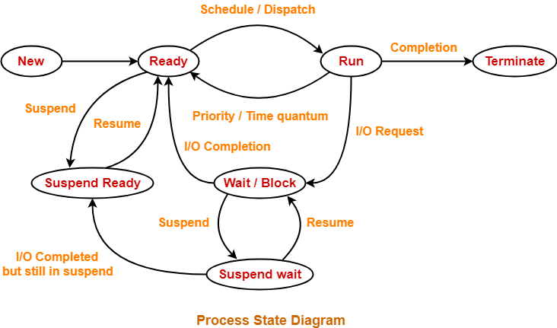
Process State Diagram
Fig. 1

Slide 11
Why CPU Scheduling?
Fair allocation of CPU.
Max CPU utilization
Max throughput
Min turnaround time
Min waiting time
Min response time

Slide 12
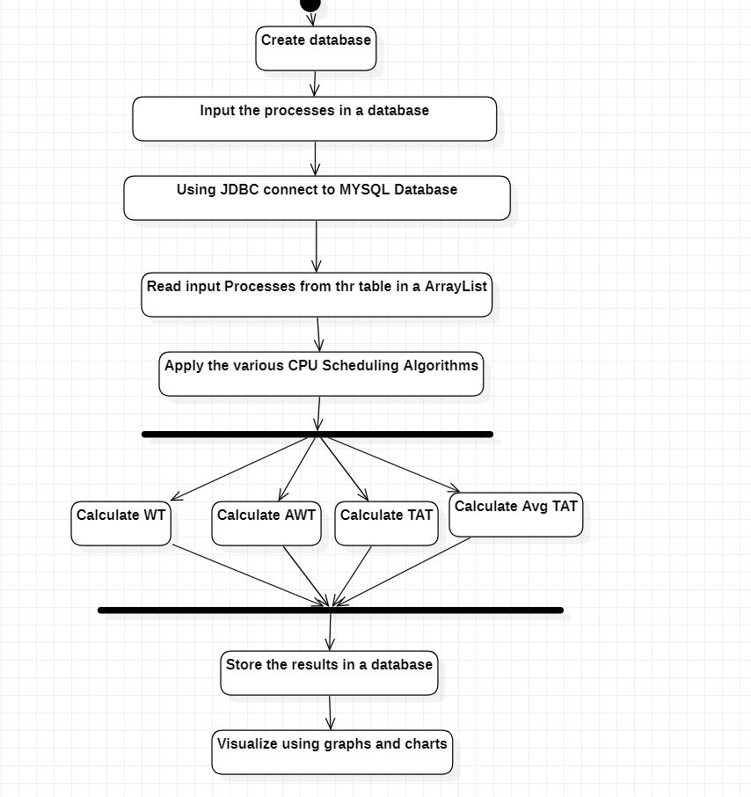
Activity Diagram
Fig. 2

Slide 13
Algorithms
The logic of different CPU scheduling algorithms which can be used to complete the objective of this project are as follows:
FCFS (First Come First Serve) Scheduling Algorithm: The basic logic for this algorithm is as follows:
START
1. Input the processes along with their burst time (bt).
2. Find waiting time (wt) for all processes.
3. As first process that comes need not to wait so waiting time for process 1 will be 0 i.e. wt[0] = 0.
4. Find waiting time for all other processes i.e. for i ->1 to n wt[i] = (sum of bt for i -> 0 to i-1) - at[i].
5. Then find turnaround time for all processes i.e. for i->0 to n tat[i] =bt[i]+ wt[i];
6. Then find average waiting time = total_waiting_time / no_of_processes.
7. After that find average turnaround time = total_turn_around_time / no_of_processes.
END

Slide 14
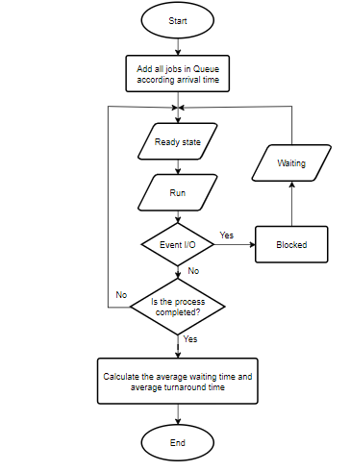
Fig. 3

Slide 15
RR (ROUND ROBIN) Scheduling Algorithm: The logic for this algorithm is as follows:
START
1. First create an array rem_bt[] to keep track of remaining burst time of processes. This array is initially
a copy of bt[] (burst times array).
2. Now create another array wt[] to store waiting times of processes.
3. Initialize this array as 0.
4. Initialize time : t = 0.
5. for i'th process if it is not done yet.
6. If rem_bt[i] >= quantum
7. t = t + quantum
8. bt_rem[i] -= quantum;
9. Else
10. t = t + bt_rem[i];
11. wt[i] = t - bt[i];
12. bt_rem[i]=0;
END;

Slide 16
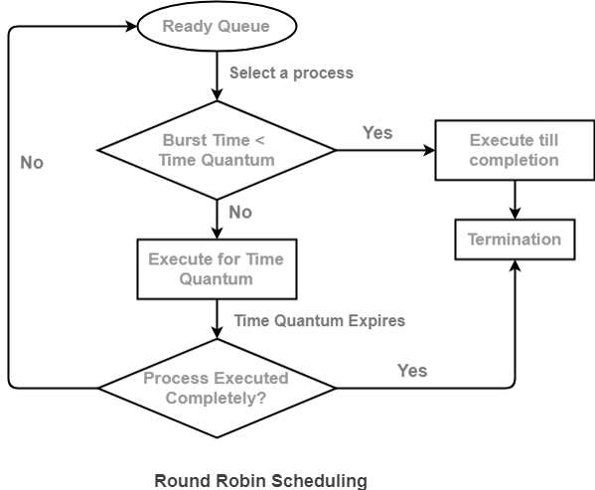
Fig. 4

Slide 17
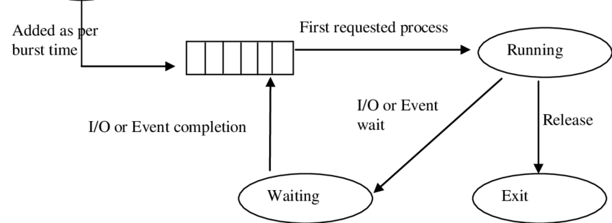
SJF ( Shortest Job First) Scheduling Algorithm: The logic for this algorithm is as follows:
1- Sort all the processes in increasing order a according to burst time.
2- Then simply, apply FCFS.
Fig. 5

Slide 18
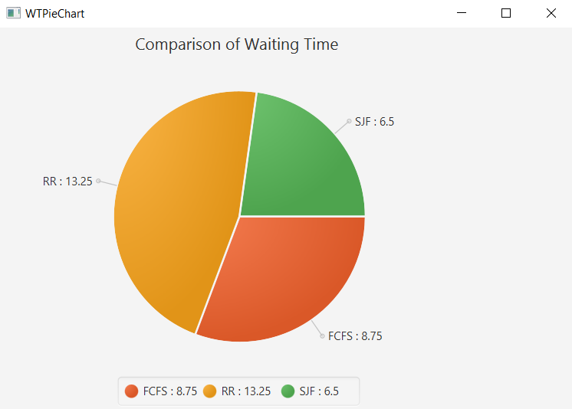
Output
Fig. 6

Slide 19
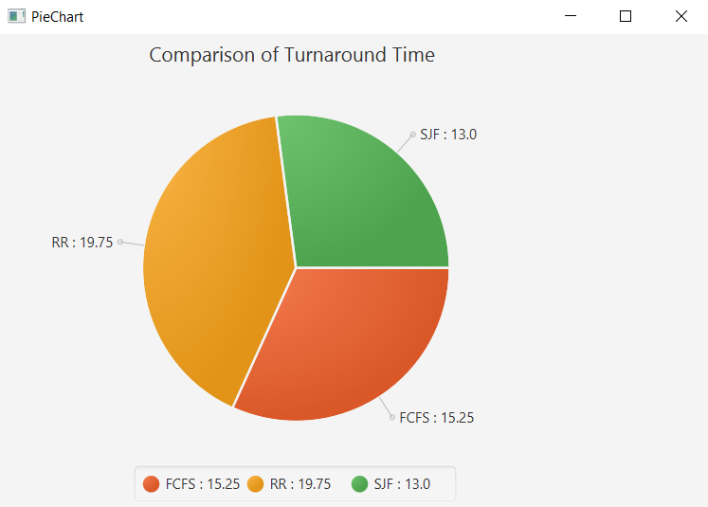
Output
Fig. 8

Slide 20
System Requirements
Software : JDK, MySQL , Connector
Hardware: Windows OS.
32/64 bit Processor.
4 GB RAM.

Slide 21
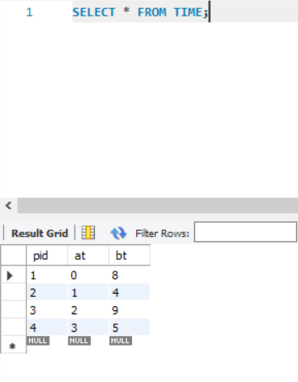
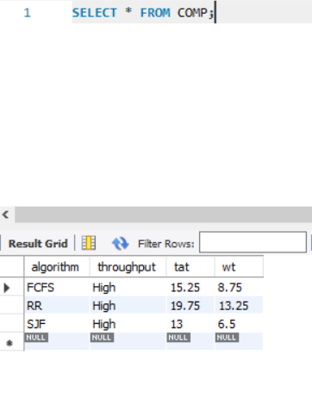
Database
Fig. 12
Fig. 13

Slide 22
Pert Chart
Planning
Start date-20/01/2021
End Date-27/01/2021
Requirement Analysis
Start Date-01/02/2021
End Date-08/02/2021
Product Design
Start Date-11/02/2021
End Date-26/02/2021
START
Debug
Start Date- 24/04/2021
End Date- 1/05/2021
Testing
Start Date- 16/04/2021
End Date- 23/04/2021
Coding
Start Date-01/03/2021
End Date- 15/04/2021
END

Slide 23
Limitations
Non Premptive , Starvation
Longer processes will suffer starvation.
Efficency depends on time quantum.
FCFS
SJF
Round Robin

Slide 24
Conclusions
Through Visualization of CPU scheduling algorithms we can easily identify that which scheduling algorithms is best since we have a chart showing average waiting time and average turn around time of different algorithms thereby easily comparative.

Slide 25
References
Shahram Saeidi Ph.D, Hakimeh Alemi Baktash (2018),ResearchGate. Retrieved from: Optimum Time Quantum
A. Silberschatz, P. B. Galvin, and G. Gagne Book Retrieved from : Reading Materials for CPU Scheduling
Lalit Kishor, Dinesh Goyal (2013) Retrieved from : Analysis of Various Scheduling Algorithm
Andysah Putera Utama Siahaan ResearchGate (2016) Retrieved from : Comparison Analysis of CPU Scheduling

Slide 26
THANK YOU!

